Slide 1

Capstone Project
AI Resume Screening System
CSA1711-Artificial Intelligence
Course Faculty: Dr. Krishna Kumar Kathiresan
Presented By:
M.S.Naveen(192371002)
A.Khaja Hussain(192572118)
P.Divakaran(192424260)
Kishore S.P(192511081)

Slide 2


Introduction
The AI Resume Screening System is an intelligent recruitment solution designed to automate and improve the process of evaluating job applicants. Traditional resume screening is often time-consuming, labor-intensive, and prone to human bias, especially when recruiters must review a large number of applications. This project addresses these challenges by leveraging Artificial Intelligence (AI) and Natural Language Processing (NLP) to analyze resumes, extract relevant candidate information, and compare it with job requirements.

Slide 3
Objective of the AI Resume Screening System
The primary objective of the AI Resume Screening System is to automate and improve the resume screening process using Artificial Intelligence (AI) and Natural Language Processing (NLP). The system analyzes resumes, extracts relevant information, compares candidate qualifications with job requirements, and ranks applicants based on their suitability. This helps recruiters reduce manual effort, minimize bias, save time, and identify the most qualified candidates more efficiently.
Key Objectives:
Automate the resume screening and shortlisting process.
Extract important candidate details such as skills, education, experience, and certifications.Match resumes with job descriptions using AI and NLP techniques.

Slide 4
Techniques Used:
TF-IDF (Term Frequency–Inverse Document Frequency)
Converts resume and job-description text into numerical vectors.
Gives higher importance to relevant skills and keywords.
Cosine Similarity
Compares the resume vector with the job-description vector.
Produces a similarity score indicating how closely the candidate matches the job.
Named Entity Recognition (NER)
Extracts useful information such as candidate names, organizations, education, and other entities from resumes.

Slide 5
Algorithm / Technique | Where used in your project
TF-IDF | Resume parsing and job-description analysis
NLP (Natural Language Processing) | Compare important words/skills in resumes and job descriptions
Cosine Similarity | Calculate resume ↔ job-description similarity
Named Entity Recognition (NER) | Extract names, organizations, degrees, skills, etc.
Machine Learning | Candidate ranking/classification
Decision Tree | Determine whether a candidate satisfies requirements
Random Forest | Candidate suitability prediction
K-Means Clustering | Group candidates based on skills/profile similarity
Recommendation System | Skill-gap and learning-resource recommendations

Slide 6
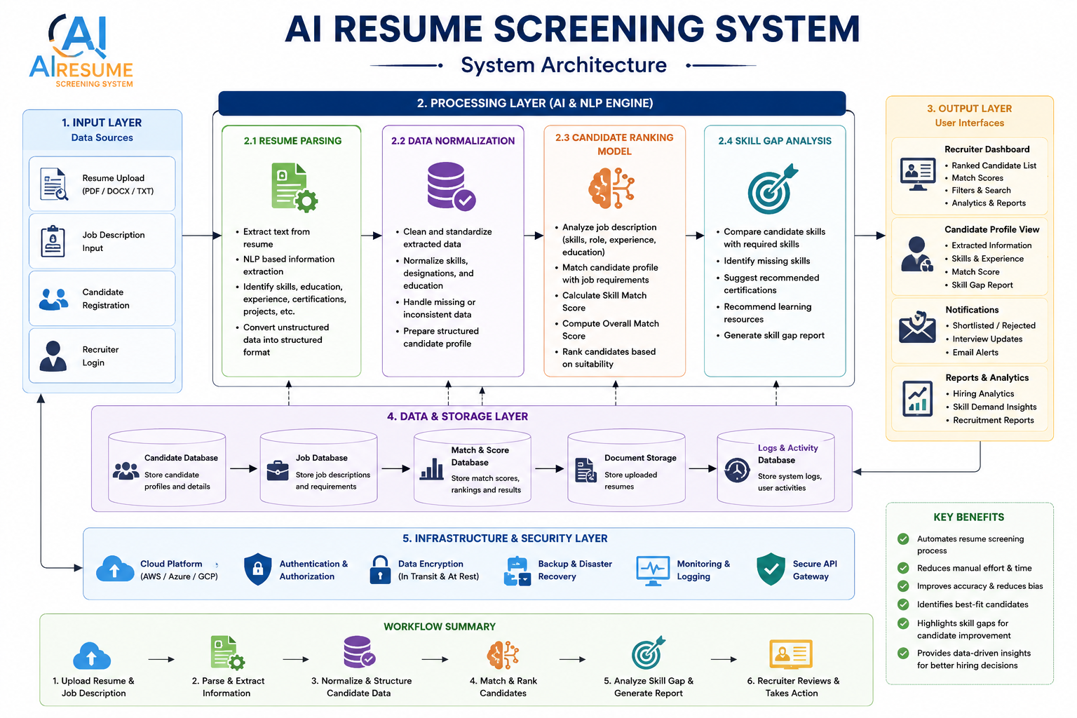
Algorithm / Technique | Where used in your project
TF-IDF | Resume parsing and job-description analysis
NLP (Natural Language Processing) | Compare important words/skills in resumes and job descriptions
Cosine Similarity | Calculate resume ↔ job-description similarity
Named Entity Recognition (NER) | Extract names, organizations, degrees, skills, etc.
Machine Learning | Candidate ranking/classification
Decision Tree | Determine whether a candidate satisfies requirements
Random Forest | Candidate suitability prediction
K-Means Clustering | Group candidates based on skills/profile similarity
Recommendation System | Skill-gap and learning-resource recommendations

Slide 7
Module 1: Resume Parsing
Description:
Resume Parsing is the process of automatically extracting important information from a candidate's resume using Artificial Intelligence (AI), Natural Language Processing (NLP). It converts resumes in PDF, DOCX, or TXT format into structured data that recruiters and Applicant Tracking Systems (ATS) can easily search and analyze.
Functions :
Extracts candidate information.
Identifies skills and qualifications.
Organizes resume data into a structured format.
Matches resumes with job descriptions.
Filters and ranks candidates,Stores data in an ATS.
Outcome:
This module eliminates manual data entry and prepares structured candidate information for accurate evaluation.

Slide 8
Module 2: Candidate Ranking Model
Description:
The Candidate Ranking Model compares the extracted resume information with the job description and calculates a suitability score for each applicant. AI and machine learning algorithms evaluate how well a candidate matches the job requirements.
Functions:
Analyze job descriptions and required skills.
Compare candidate skills, education, and experience with job requirements.
Calculate a matching score based on predefined criteria.
Rank candidates from highest to lowest suitability.
Filter candidates based on minimum qualifications or specific requirements.
Outcome:
Recruiters receive a prioritized list of applicants, allowing them to focus on the most suitable candidates and reducing the time required for screening.

Slide 9
Module 3: Recruiter Dashboard
Description:
The Recruiter Dashboard provides an easy-to-use interface for recruiters to manage job postings, review ranked candidates, and monitor the recruitment process.
Functions:
Display ranked candidate lists with matching scores.
View detailed candidate profiles and extracted resume information.
Search and filter candidates by skills, experience, education, or score.
Track application status (e.g., shortlisted, interviewed, selected, rejected).
Generate reports and analytics on recruitment activities.
Outcome:
This module simplifies recruitment management by providing recruiters with a centralized dashboard for efficient decision-making and candidate tracking.

Slide 10
Module 4: Candidate Skill Gap Analysis
Description:
This module identifies missing skills by comparing candidate profiles with job requirements.
Functions:
Detect missing technical skills.
Suggest recommended certifications.
Recommend learning resources.
Display skill gap reports.
Generate candidate improvement recommendations.
Outcome:
Helps candidates understand areas for improvement and assists recruiters in evaluating training needs.

Slide 11
Data Set Explanation
Column Name | Description | Example
Candidate_ID | Unique identifier for each candidate | C001
Candidate_Name | Full name of the candidate | John Smith
Email | Candidate's email address | john@gmail.com
Phone_Number | Contact number | 9876543210
Degree | Highest educational qualification | B.Tech
Specialization | Field of study | Computer Science
University | University/College name | XYZ University
Graduation_Year | Year of graduation | 2024
CGPA/Percentage | Academic performance | 8.5 CGPA
Experience_Years | Total work experience (in years) | 2
Current_Job_Title | Current or previous job role | Software Engineer
Technical_Skills | Programming and technical skills | Python, Java, SQL, Machine Learning
Soft_Skills | Communication and interpersonal skills | Teamwork, Communication
Certifications | Professional certifications | AWS Cloud Practitioner
Projects | Major academic/professional projects | AI Chatbot
Resume_Text | Extracted text from the resume (optional) | Full resume text
Job_Role_Applied | Position applied for | Data Analyst
Required_Skills | Skills required for the applied job | Python, SQL, Excel
Skill_Match_Score | Percentage of skill match | 88%
Education_Match | Whether education matches job requirements | Yes
Experience_Match | Whether experience matches job requirements | Yes
Overall_Match_Score | Final AI-generated candidate score | 91%
Candidate_Rank | Rank assigned by the system | 1
Shortlisted | Final selection status | Yes

Slide 12
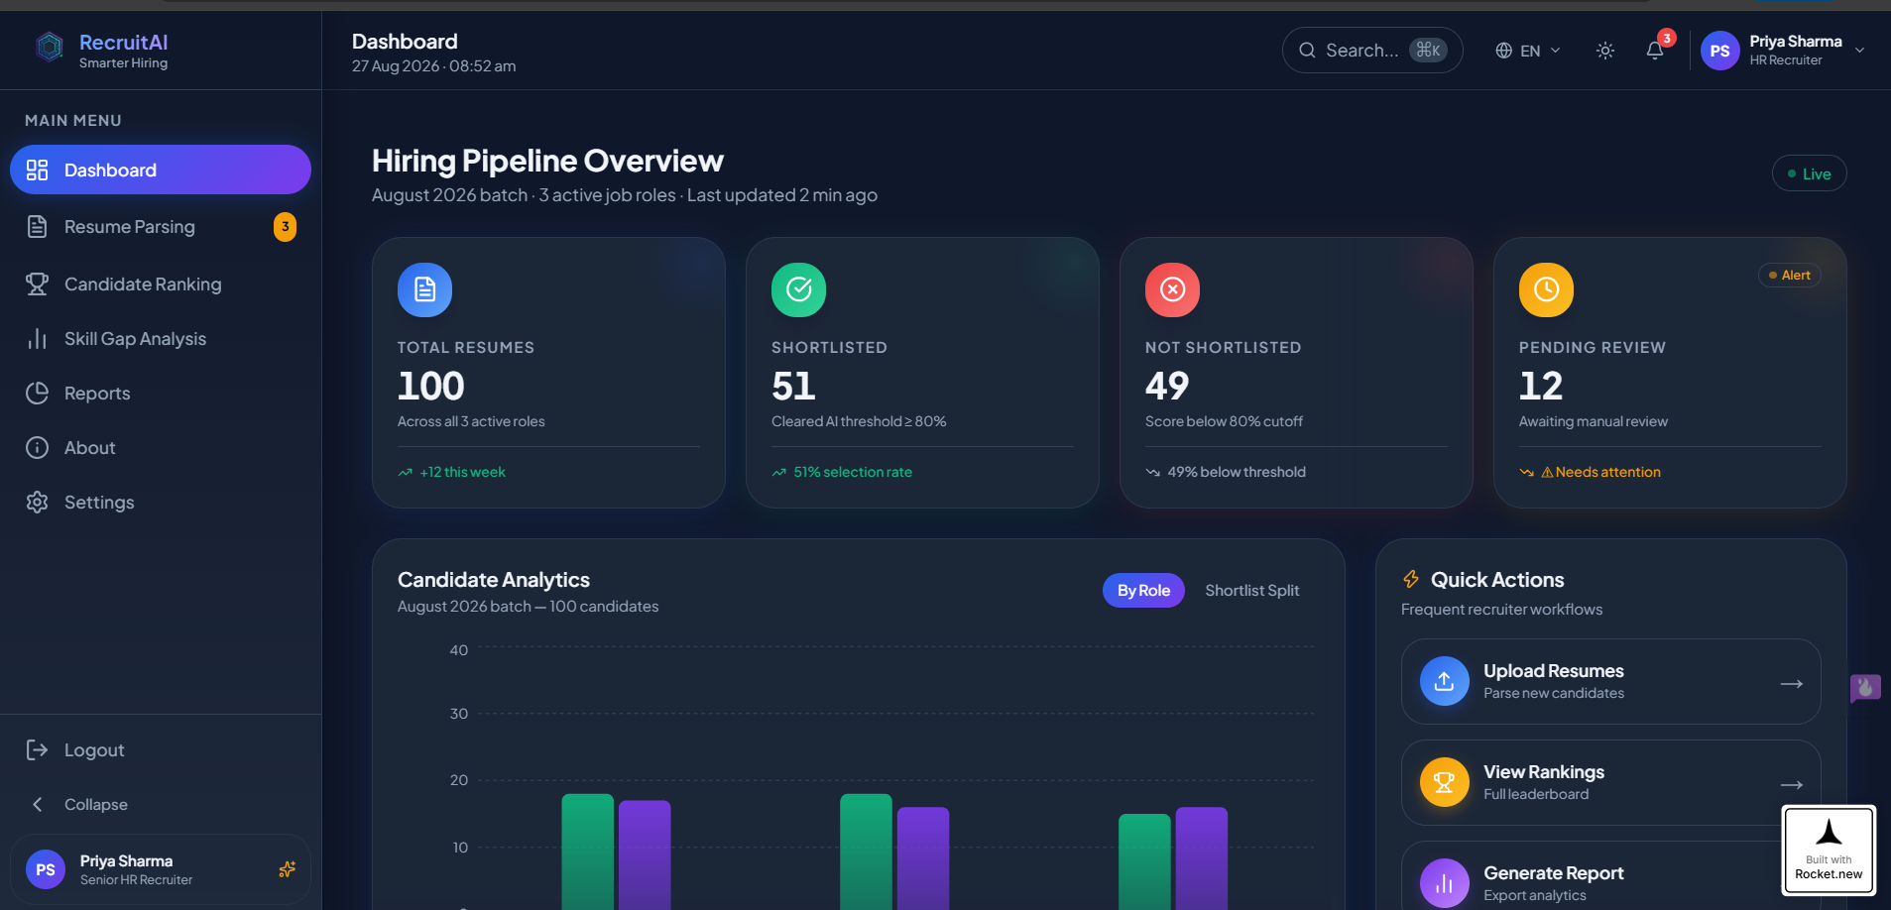

Slide 13
Result
The AI Resume Screening System successfully automates the resume evaluation and candidate shortlisting process. The system extracts key information from candidate resumes, including skills, education, work experience, certifications, and projects, and compares this information with the job requirements. Based on the level of matching, it generates an overall match score, ranks candidates according to their suitability, and presents the results through a recruiter dashboard.
The developed system reduces the time required for manual resume screening, improves the consistency of candidate evaluation, and helps recruiters quickly identify the most suitable applicants. Additionally, the Skill Gap Analysis module identifies missing skills and provides recommendations for candidate improvement. Overall, the system demonstrates that AI and NLP techniques can make the recruitment process faster, more efficient, and more organized.

Slide 14
Conclusion
The AI Resume Screening System provides an intelligent and automated approach to modern recruitment by integrating Artificial Intelligence (AI) and Natural Language Processing (NLP) into the resume screening process. The system streamlines candidate evaluation through resume parsing, candidate ranking, recruiter dashboard management, and skill gap analysis, enabling recruiters to make informed hiring decisions with reduced manual effort.
This project demonstrates how AI can enhance recruitment efficiency by organizing candidate information, matching resumes with job requirements, and generating ranked candidate lists. It also supports candidates by identifying skill gaps and recommending areas for improvement.

Slide 15


